Slide 1

Green Pace
Security Policy Presentation
Developer: Shawn Carrier
CS 405 Secure Coding
Mike Prasad
Southern New Hampshire University
18 June 2023

Slide 2

OVERVIEW: DEFENSE IN DEPTH
Defense in depth is the approach to information security where security mechanisms are carefully, and thoughtfully, layered in order to create stronger protection against attempted attacks, risks, and possible vulnerabilities in a system.

Slide 3
THREATS MATRIX
Probability | Severity
 | High | Medium | Low
Likely | STD-001-CPP
 | STD-002-CPP
 | STD-003-CPP
 | STD-004-CPP
 | STD-005-CPP
Probable | STD-009-CPP |  | STD-007-CPP
 | STD-010-CPP
Unlikely |  | STD-008-CPP | STD-006-CPP

Slide 4
10 PRINCIPLES
Validate Input Data
STD-001-CPP
STD-002-CPP
STD-003-CPP
STD-004-CPP
Heed Compiler Warnings
STD-002-CPP
STD-003-CPP
STD-009-CPP
Architect and Design for Security Policies
STD-002-CPP
STD-004-CPP
STD-005-CPP
STD-006-CPP
STD-007-CPP
STD-010-CPP
Keep it Simple
STD-008-CPP
STD-010-CPP
Default Deny
Adhere to the Principle of Least Privilege
Sanitize Data Sent to Other Systems
STD-003-CPP
Practice Defense in Depth
STD-004-CPP
Use Effective Quality Assurance Techniques
STD-001-CPP
STD-002-CPP
STD-003-CPP
STD-005-CPP
STD-006-CPP
STD-007-CPP
Adopt a Secure Coding Standard
STD-005-CPP
STD-006-CPP
STD-007-CPP
STD-009-CPP
STD-010-CPP

Slide 5
CODING STANDARDS
Rule | Severity | Likelihood | Remediation Cost | Priority | Level
STD-001-CPP | High | Likely | High | P9 | L2
STD-002-CPP | High | Likely | High | P9 | L2
STD-003-CPP | High | Likely | Medium | P18 | L1
STD-004-CPP | High | Likely | Medium | P18 | L1
STD-005-CPP | High | Likely | Medium | P18 | L1
STD-006-CPP | Low | Unlikely | High | P1 | L3
STD-007-CPP | Low | Probable | Medium | P4 | L3
STD-008-CPP | Medium | Unlikely | Medium | P4 | L3
STD-009-CPP | High | Probable | High | P6 | L2
STD-010-CPP | High | Probable | High | P6 | L2

Slide 6
ENCRYPTION POLICIES
Encryption in rest protects stored data, such as hard drives, phones, computers, etc.
Encryption at flight protects data that is moving between devices, such as email encryption, DLP solutions, and network security features.
Encryption in use protects data that is created, edited, or in-use.

Slide 7
TRIPLE-A POLICIES
Authentication is the act of confirming one’s identity.
Authorization specifies the access control rights and privileges of a user.
Accounting keeps track of system activity.

Slide 8
Unit Testing
Unit testing verifies and validates components of a program or application, in order to ensure the app will act and respond as intended.
Testing done with Google Test, linked below
https://github.com/google/googletest/

Slide 9
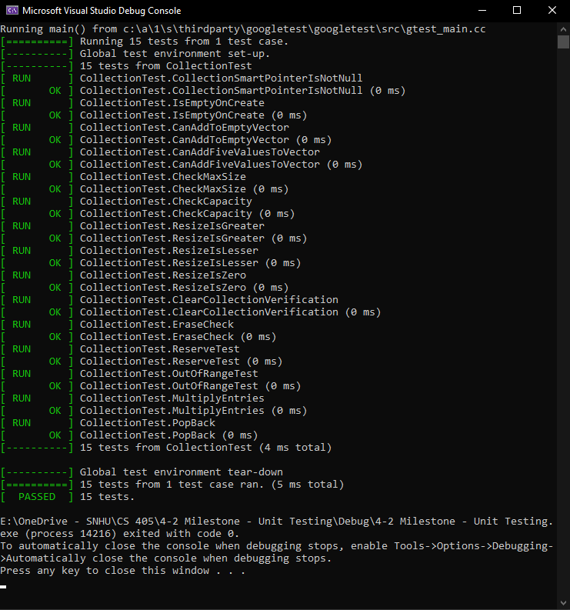
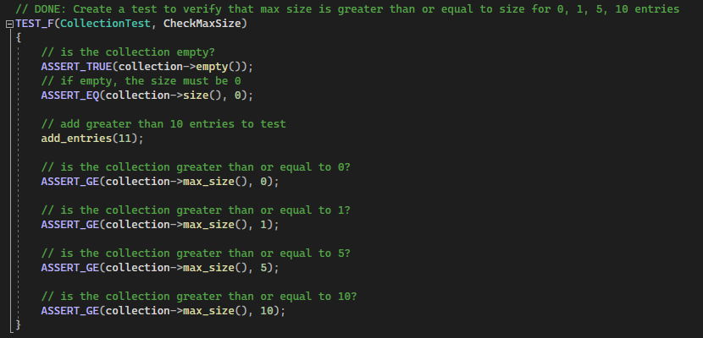
CheckMaxSize
Test to verify max size is greater or equal to size for x number of entries.

Slide 10
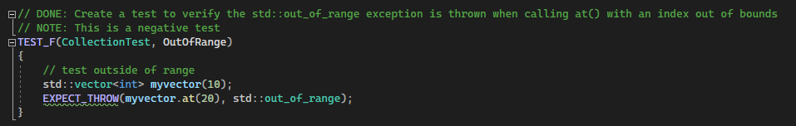
OutOfRange
Test to verify an out-of-range exception is thrown when calling out of bounds.

Slide 11
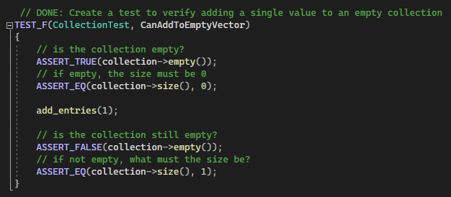
CanAddToEmptyVector
Test to verify that empty vectors can have values entered into them

Slide 12
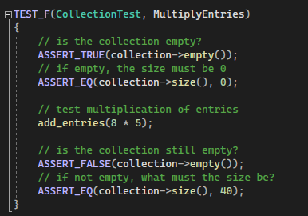
MultiplyEntries
Test to verify that you can add multiplicative entries to collections

Slide 13

AUTOMATION SUMMARY

Slide 14
TOOLS
According to RedHat.com, DevSecOps means thinking about application and infrastructure security from the start.
CPPCheck is used primarily for static code analysis. (https://cppcheck.sourceforge.io/)
Clang is a front-end compiler
(https://clang.llvm.org/)
Parasoft is a full-on automated testing suite
(https://www.parasoft.com/)

Slide 15
RISKS AND BENEFITS
Risks of waiting to deploy security
Harm to data
Harm to trust
Financial cost of fixing breach
Potential customer damages
Potential for multiple future attacks
Benefits to early action
Mitigate potential damage and cost
Secure user data
Security structure is implemented
Reduce possible overhead testing
Helps to prevent more vulnerable areas
Example Case
Microsoft Customer Records Data Breach from 28 – 30 December, 2020
Data accrued by Microsoft from 2005 through 2019 from customer support was attacked and stolen, including email addresses, IP addresses, and internal confidential documents.

Slide 16
RECOMMENDATIONS
The largest gap in the security policy is not enforcing regular reviews and updates.
Utilization of white-hat organizations as an outside source to review the security policy could help provide a real-world test to find potential vulnerabilities and security risks.
Early implementation of these security policies can help ensure security is consistently at the forefront of company policy, and ease potential customer tensions.

Slide 17
CONCLUSIONS
1. Adopting best practices and coding standards.
2. Defense in Depth
3. Considering attack motives during development and security reviews
These three aspects can aid in transitioning Green Pace from a DevOps organization to a DevSecOps one.

Slide 18
REFERENCES
Argintaru, D. (2021). Data Encryption: How to Protect Data in Transit, Data in Use and Data at Rest. Mimecast.com. https://www.mimecast.com/blog/data-in-transit-vs-motion-vs-rest/
Authentication, Authorization, Accounting and Identity Management. (2018, April 3). CCSI. https://www.ccsinet.com/blog/aaa-identity-management/
Symanovich, S. (2021, February 4). Microsoft accidentally exposed 250 million customer records - what you should know. Data Breaches. https://lifelock.norton.com/learn/data-breaches/microsoft-exposed-250-million-customer-records
What is DevSecOps? (2021). Redhat.com. https://www.redhat.com/en/topics/devops/what-is-devsecops

